Slide 1
Happy Shop
Present By
Shubham R Balar (B.tech 3rd sem)
Enrollment no: 19SE02CE003
P. P. Savani University

Slide 2
OverView
Introduction
Online shopping vs traditional shopping
Advantages of online shopping
Limitation of online shopping
Modes of payment
Online safety
Login instruction
Shopping website design
Website cart
Conclusion

Slide 3
introduction
Shopping is one of the essential part of our daily life. We are using different type of shop by different kind of thing everyday.
Today our life is divided into two parts.
-Physical life: we met everyone physically.
-Virtual life: we met people on a
virtual world called
‘Internet’.

Slide 4
Online shopping vs Traditional shopping
Online shopping
Easy to find best online stores.
Searching online styles.
Best coupon to shop.
Good discounts.
Comparisons of prices.
Available 24*7.
Traditional shopping
Time to find best store.
No discount.
No home delivery.
Not available 24*7.

Slide 5
Advantages
Save time.
Save fuel.
Save energy.
Comparison of price.
24*7 availability.
No need of waiting in lines.
Limitation
Risky credit card purchase.
A never ending wait for the product to arrive.
Deceptive pictures.
Lack of the options.
Makes you lazy.

Slide 6
Modes of payment
Cash on delivery.
Debit card.
Credit card.
Postal money order.
Billing on mobile phone.
Online Safety
Check out sellers
Make sore the site is legitimate.
Protect your information.
Keep a paper trail.
Use safe payment option.
Turn your computer off when you are finished shopping.

Slide 7
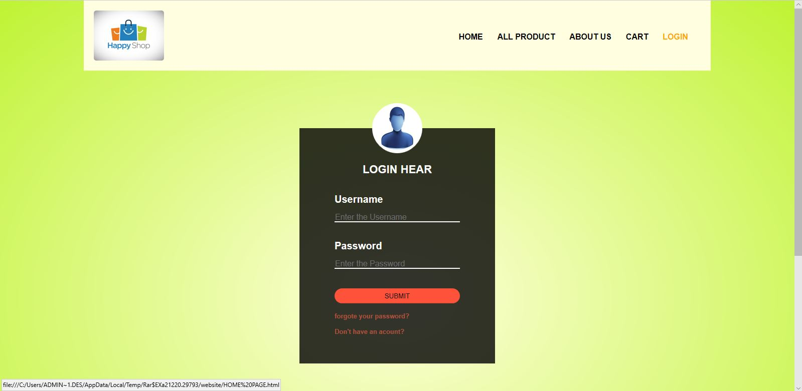
User Name
password
New user register here

Slide 8
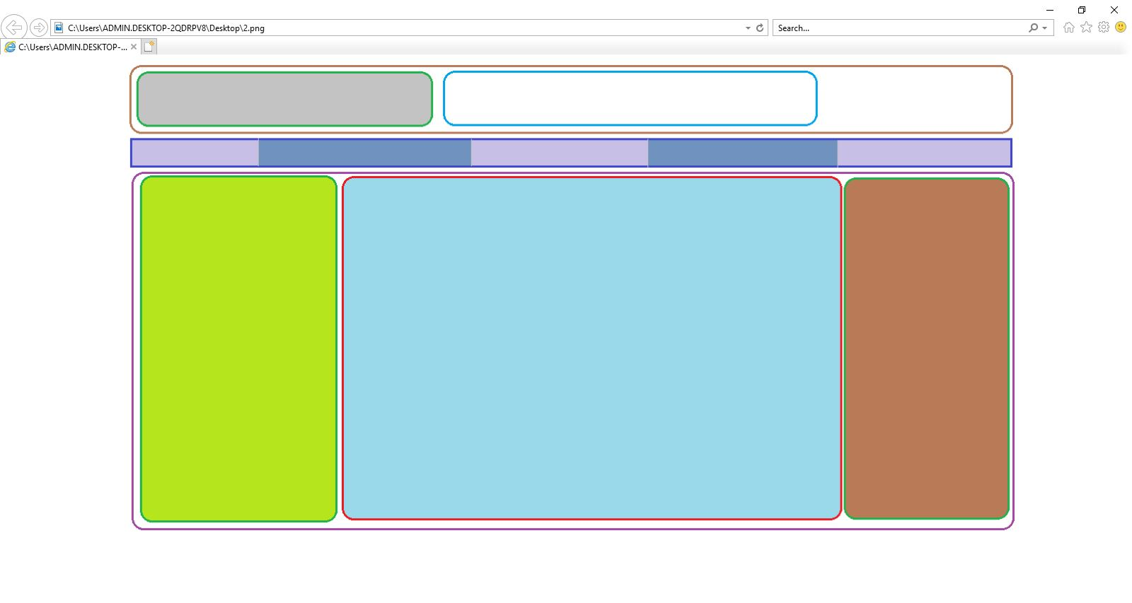
Design:
Navigation bar
Web logo
Tag line & search bar
Products
Content category
Ads

Slide 9
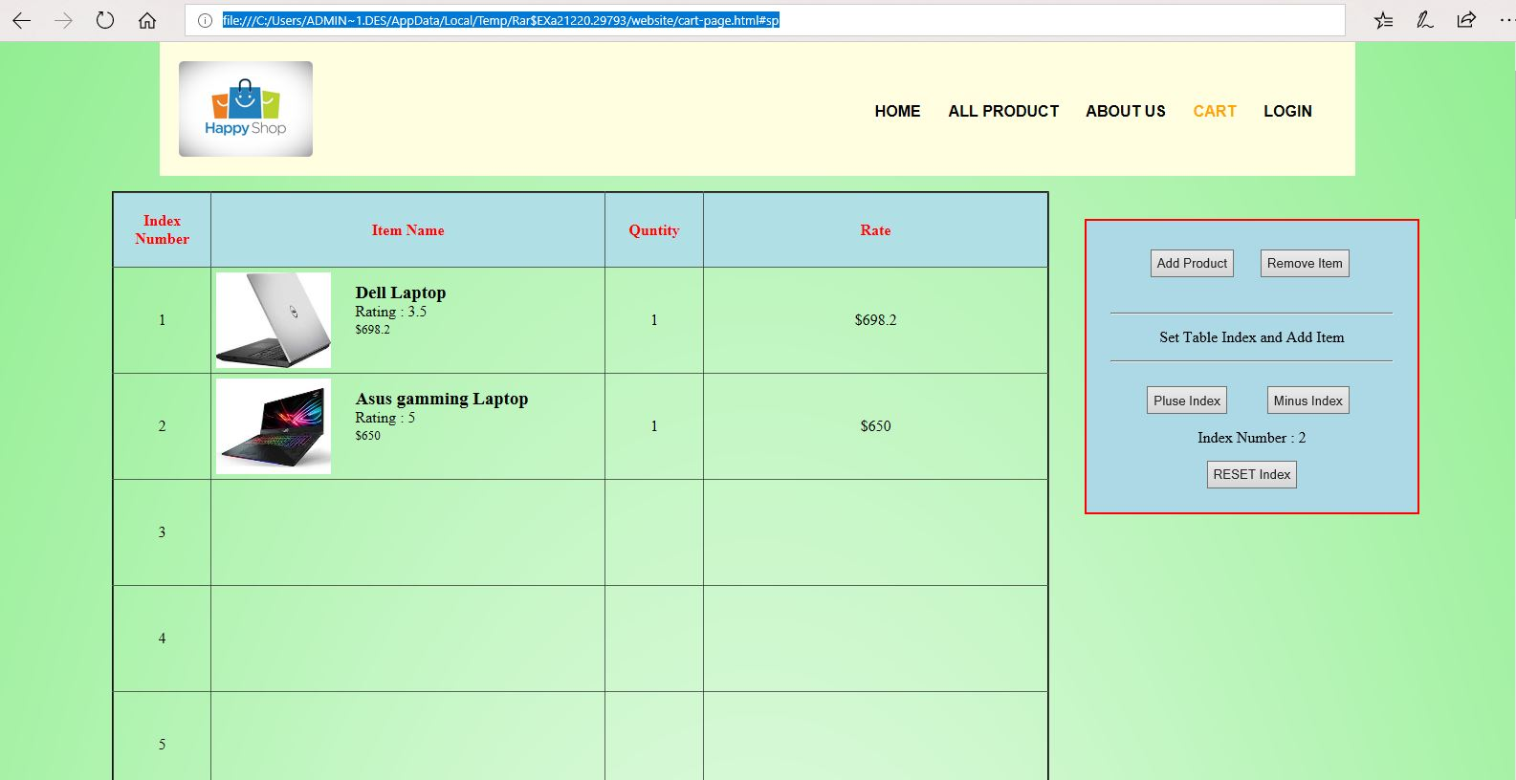
This is cart Table:
Use this box and
More product add to
cart table
qty
image
total
Detail

Slide 10
conclusion
It is an user friendly application and promotes user to purchase and shop faster.
With new technology come better way of doing things.
Being able to buy anytime anywhere.
Allows to place order before purchasing.

Slide 11
Thank you

